Slide 1


Workforce Needs For Maryland
Catalog of professional workforce needs for the State of Maryland that align to the skills and knowledge of The University of Maryland’s College of Information graduates.

Slide 2
Key Findings
Fastest growing occupation in Maryland short term (2022-2025) is Data Scientist. Projected growth of 10.67%.
Fastest growing related occupations in Maryland long term (2025-2032) are Data Scientist and Information Security Analyst. Projected growth of 39.32% and 38.81% respectively.
UMD’s Information Science program directly prepares students for these occupations through specialized courses in programming, data science, statistics, information assurance, and cybersecurity policy, aligning academic training with Maryland’s fastest growing tech occupations.

Slide 3
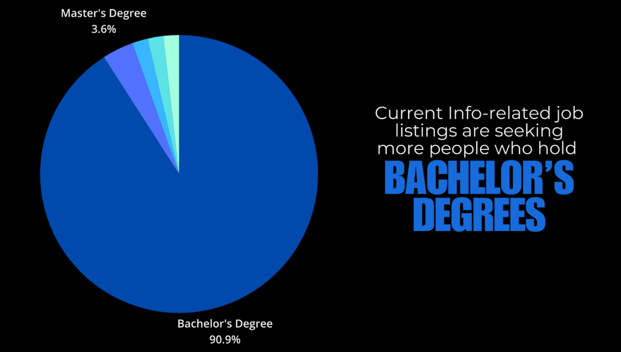

Slide 4
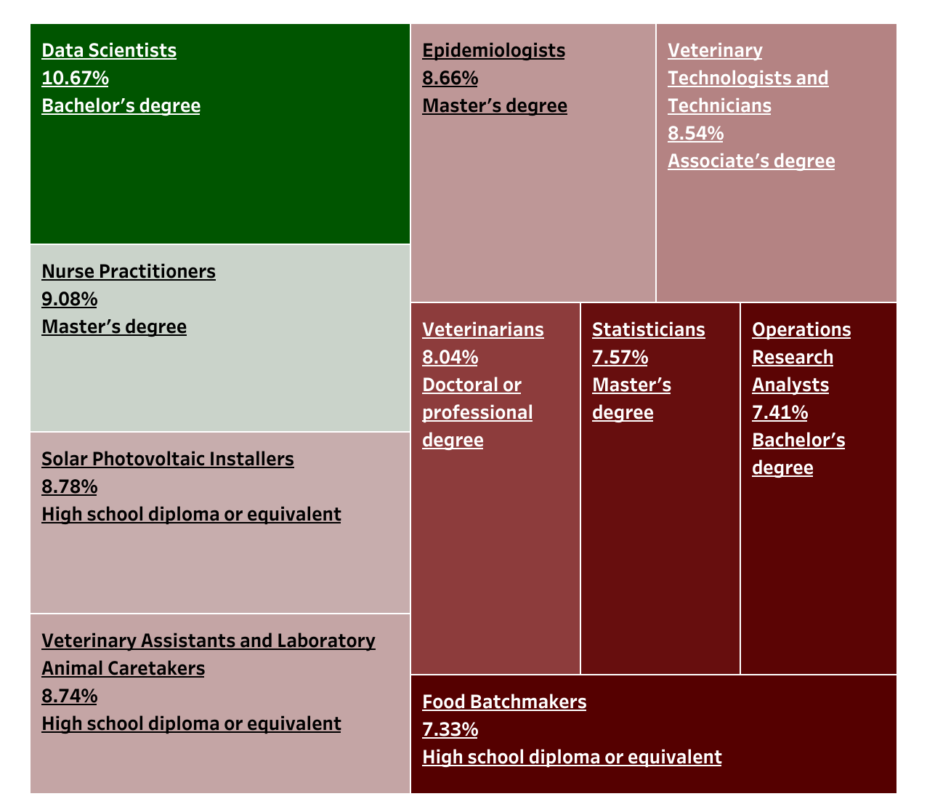
Short Term Occupational Projections (2022-2025)
Top 10 Growing Occupations with Educational Value Short Term (2022-2025)
(labor.maryland.gov/lmi/iandoproj/)

Slide 5
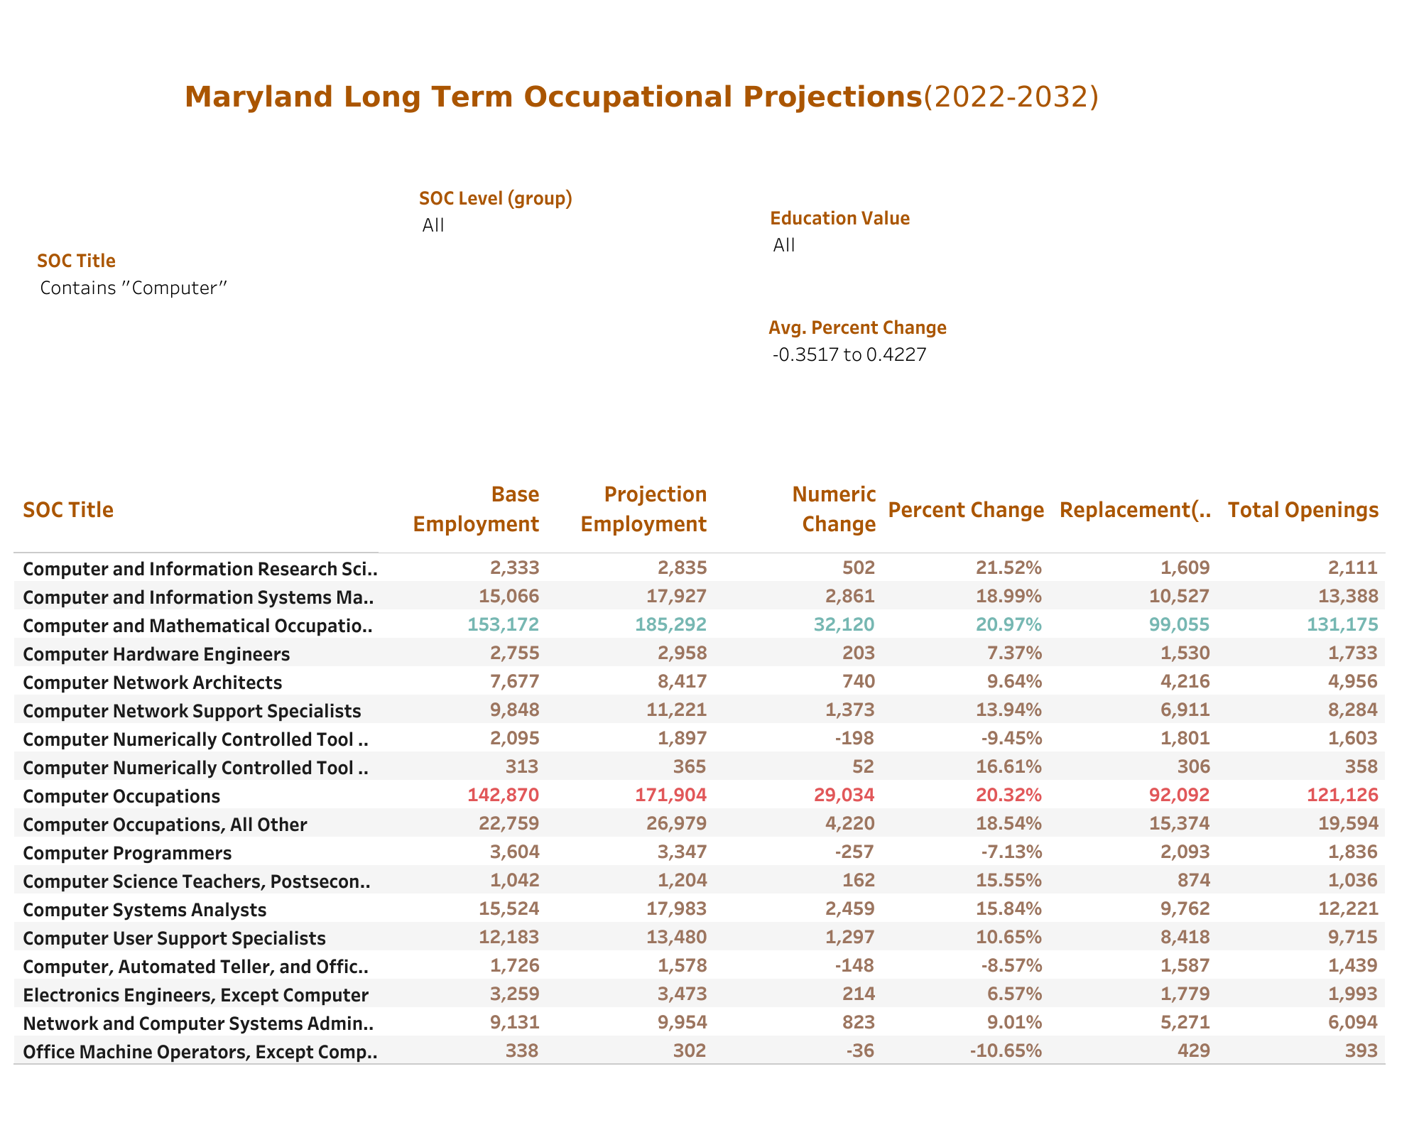
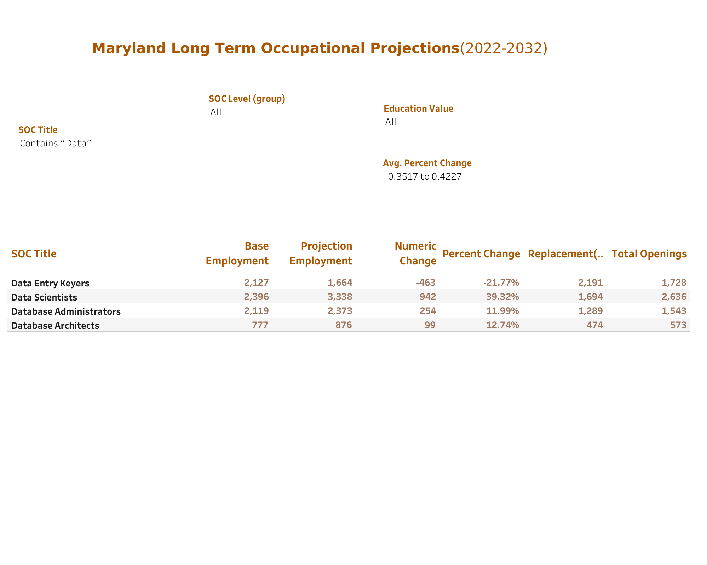
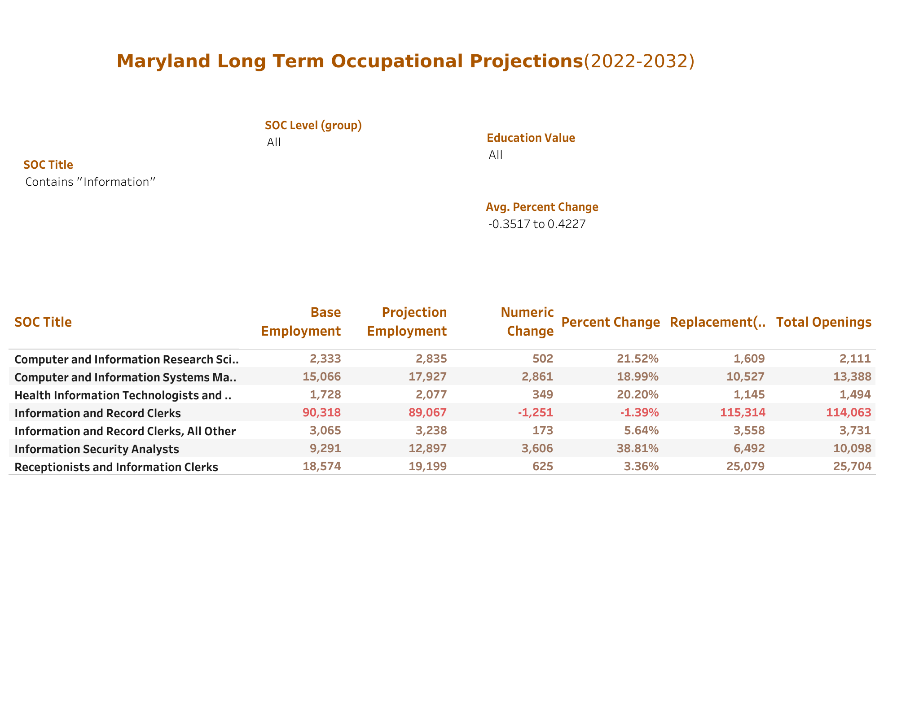
Short Term Occupational Projections (2023-2025)
Relevant Employment Projection
(labor.maryland.gov/lmi/iandoproj/)

Slide 6
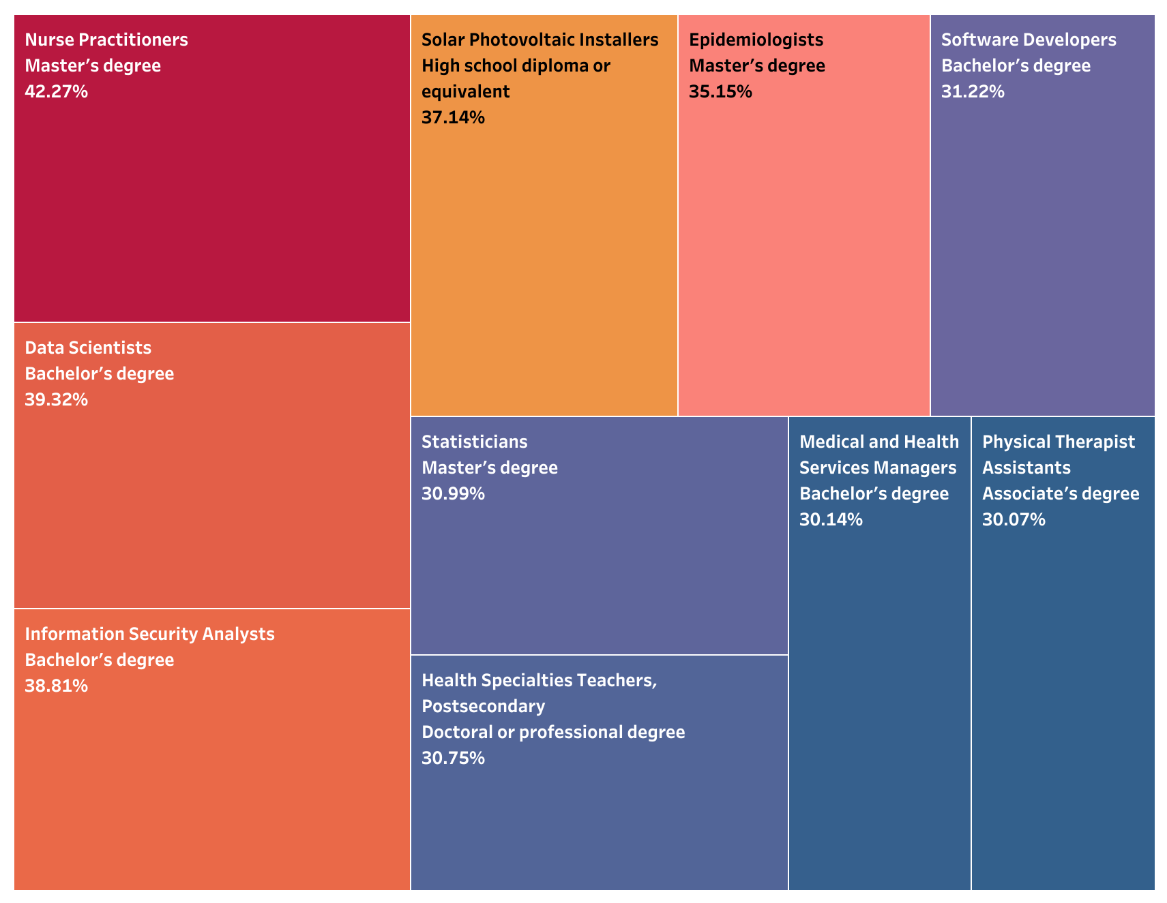
Long Term Occupational Projections (2023-2032)
Top 10 Growing Occupations with Educational Value Long Term (2022-2032)
(labor.maryland.gov/lmi/iandoproj/)

Slide 7
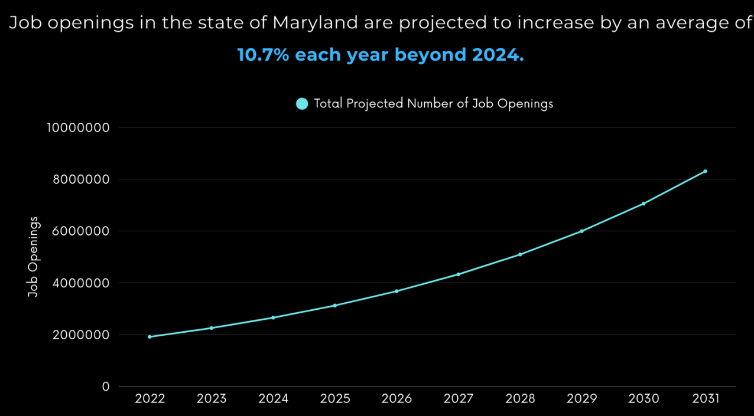

Slide 8
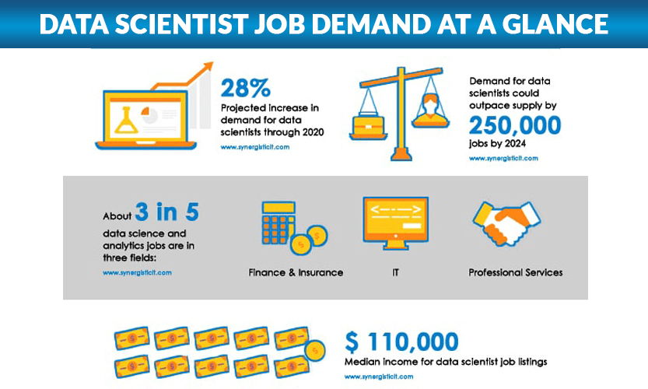
Data Scientists Workforce Needs
Short-Term Growth (2023–2025): Data Scientists are the fastest-growing occupation.
Long-Term Growth (2022–2032): Sustained demand in data analytics, big data, and business intelligence.
INFO Skills Match:
Python for data analysis
Statistical analysis and spreadsheet modeling
Database Systems, Data Management
Data visualization, bias recognition, and practical projects
Courses that offer these skills: INST126, INST127, INST314, INST326, INST327, INST354, INST414, INST447, INST452, INST462
Target Job Titles:
Data Analyst
Business Intelligence Analyst
Data Scientist
Data Engineer

Slide 9
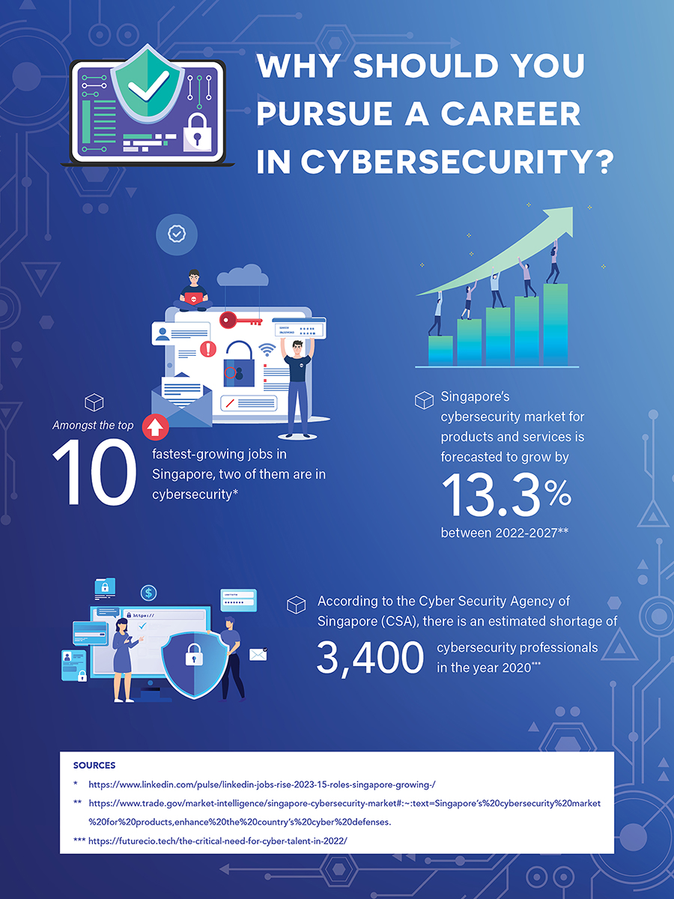
Cybersecurity & Information Security Workforce Needs
Workforce Need:
Top Long-Term Need: Information Security Analysts
Consistent demand across public sector, healthcare, and finance
INFO Skills Match:
Risk assessment, threat modeling, intrusion detection
Hands-on with tools like VPNs, firewalls, encryption methods
Courses emphasizing governance, compliance, and policy writing
Security labs, ethical hacking, and real-world security simulations
Courses that offer these skills: INST126, INST127, INST326, INST346, INST364, INST366, INST455, INST456, INST464, INST467
Target Job Titles:
Cybersecurity Analyst
Information Security Officer
SOC Analyst
Governance, Risk, & Compliance (GRC) Specialist

Slide 10
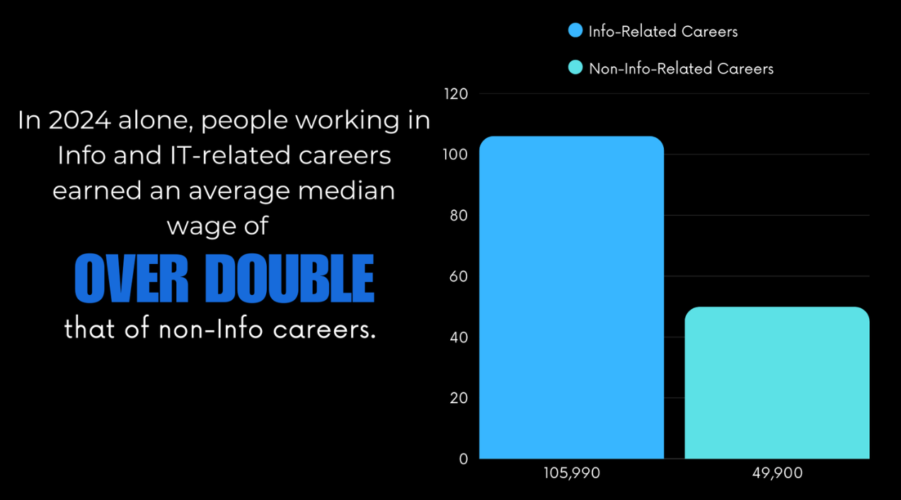

Slide 11
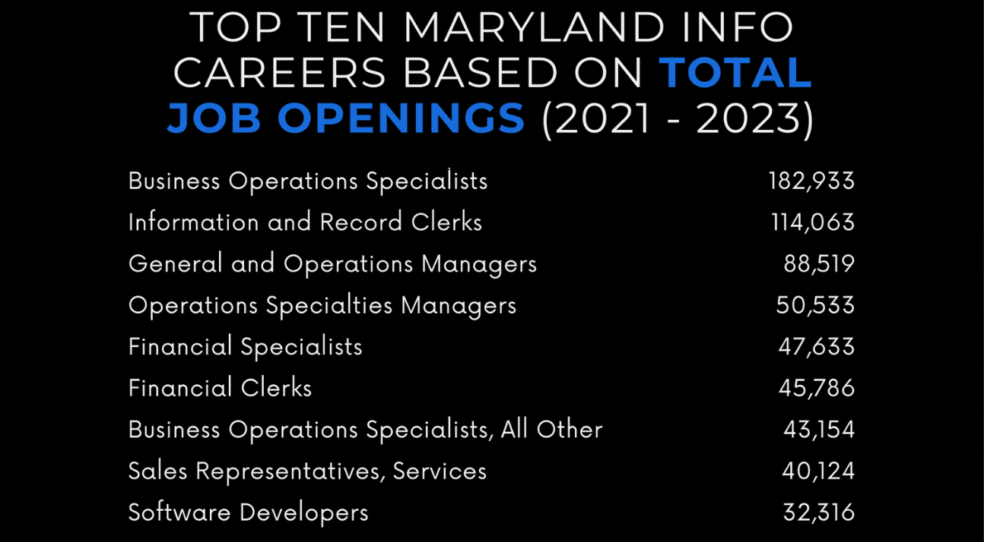

Slide 12
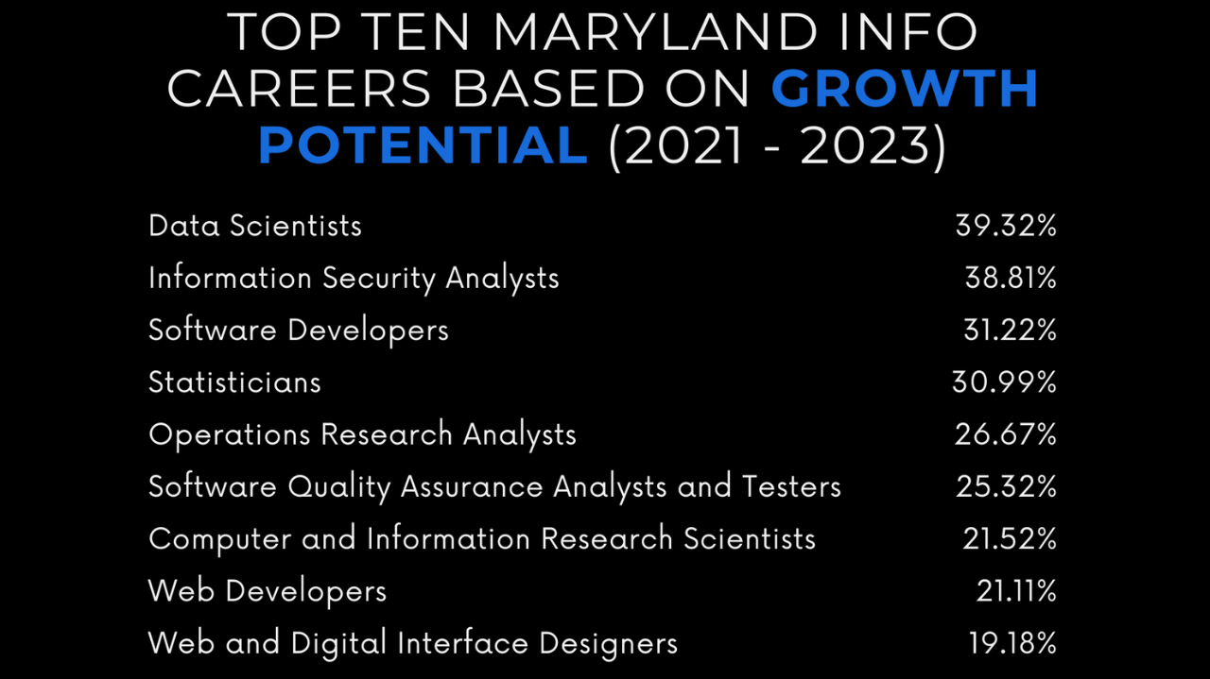

Slide 13
Key Findings
Fastest growing occupation in Maryland short term (2022-2025) is Data Scientist. Projected growth of 10.67%.
Fastest growing related occupations in Maryland long term (2025-2032) are Data Scientist and Information Security Analyst. Projected growth of 39.32% and 38.81% respectively.
UMD’s Information Science program directly prepares students for these occupations through specialized courses in programming, data science, statistics, information assurance, and cybersecurity policy, aligning academic training with Maryland’s fastest growing tech occupations.

Slide 14
Workforce Needs For Maryland
Catalog of professional workforce needs for the State of Maryland that align to the skills and knowledge of College of Information graduates.

